Slide 1
Food waste estimation using
Received Signal Strength Indicator
CSE 291 Topics in Embedded Computing and Communication
Prof. Aaron Schulman
Daniel Koohmarey
Nitish Nagesh

Slide 2
Outline
Big Picture
Challenge
Solution
Problem
Insight
Future
Big Picture
Problem
Challenge
Insight
Our Solution
Setup Considerations
Test Environment Effects
Test Results
Prediction Result
Future Work

Slide 3
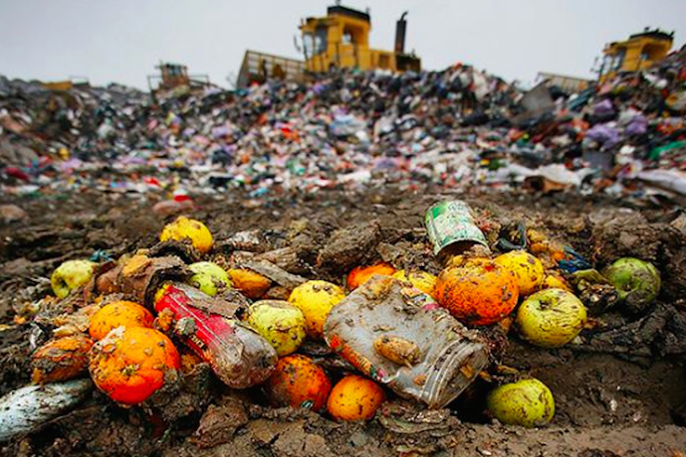
Big Picture
Big Picture
Challenge
Solution
Problem
Insight
Future
@SANDRODEMAIO /TWITTER

Slide 4
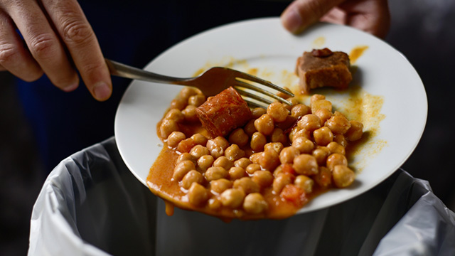
Big Picture
Big Picture
Challenge
Solution
Problem
Insight
Future
©Ntio/shutterstock.com
Notes:
U.N Food and Agriculture Organization estimates one third of food for human consumption is lost or wasted
Food waste accounts for roughly 8% of greenhouse gas emissions,

Slide 5
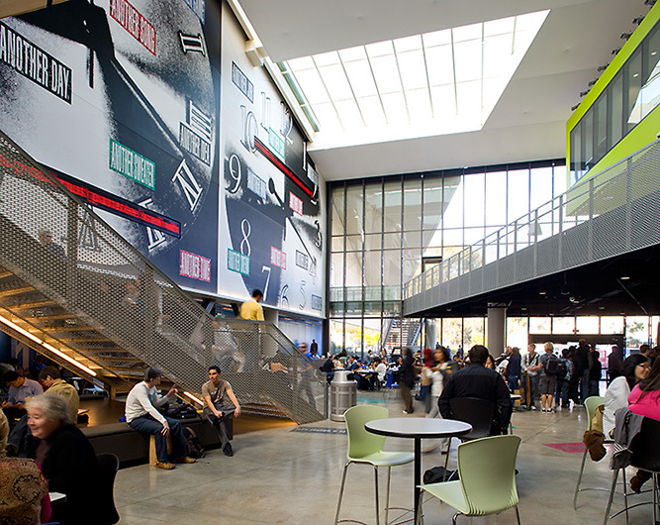
Problem
Big Picture
Challenge
Solution
Problem
Insight
Future
At the UCSD Price Center dining hall, metrics with regards to food waste at the end user are not easily gathered, requiring costly one time manual sorting and weighing of trash which fail to capture any temporal trends
UCSD dining currently uses a logistical tracking system known as FoodPro by Aurora to estimate current food waste at the inventory level, but not the food waste from what is served
https://ucsdms.wordpress.com/about/ucsd-campus/

Slide 6
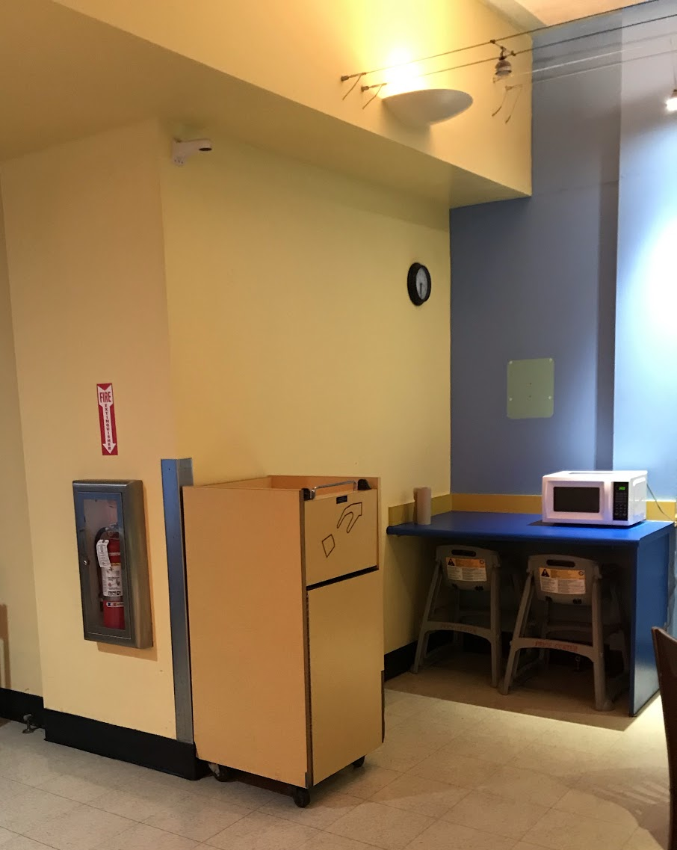
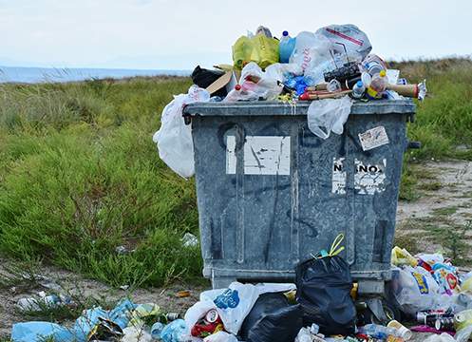
Challenges
Big Picture
Challenge
Solution
Problem
Insight
Future
Heterogeneous nature of trash
Mostly closed trash cans → difficult to use vision based techniques
Lack of cheap alternatives using existing sensors to track food waste

Slide 7
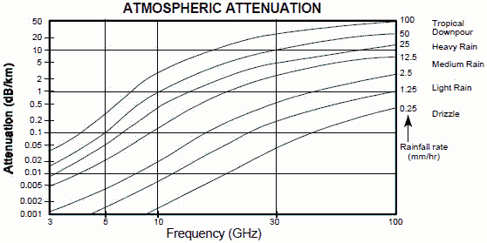
Insight
Big Picture
Challenge
Solution
Problem
Insight
Future
RF signal “attenuates” (the strength of the signal is reduced) as it passes through materials at different rates
Food waste should generally contain moisture, and water poses high attenuation due to its conductive nature*
Food waste should noticeably attenuate the RF signal proportionate to the amount of waste present
* https://ieeexplore.ieee.org/abstract/document/5345555 Wells I., Davies A., Che X., Kear P., Dickers G., Gong X., Rhodes M. Node pattern simulation of an undersea sensor network using RF electromagnetic communications
Electronic Warfare and Radar Systems Engineering Handbook

Slide 8
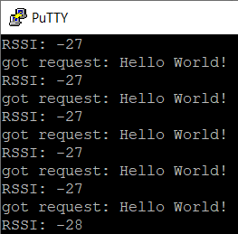
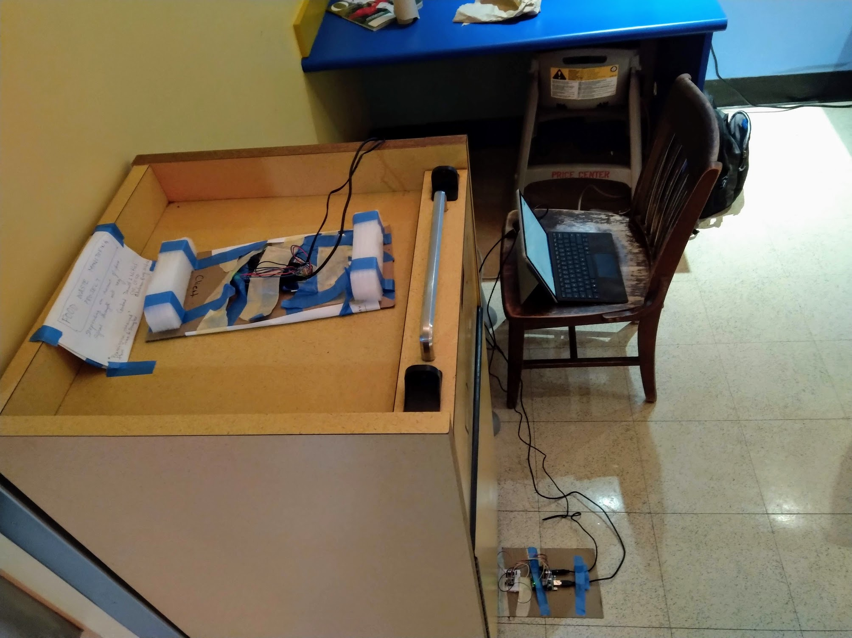
Solution
Big Picture
Challenge
Solution
Problem
Insight
Future
Received Signal Strength Indicator (RSSI) metric supported by RF transceivers can help assess magnitude of attenuation
Low cost RF transceivers can be used to estimate the amount of food waste in a trash bin by developing a model to estimate food waste based on the RSSI of a fixed signal strength passed between the contents trash bin

Slide 9
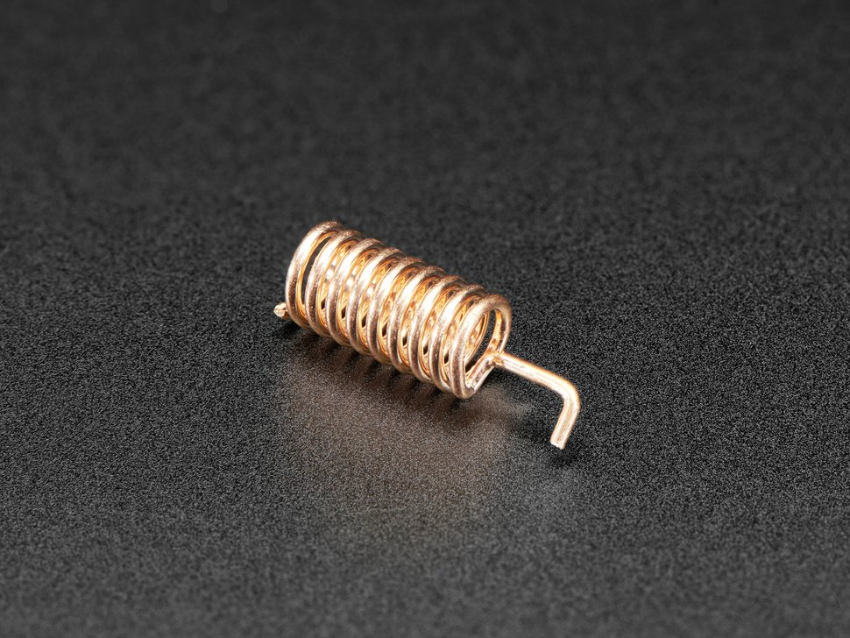
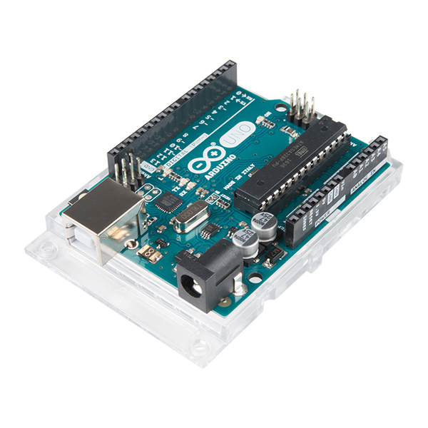
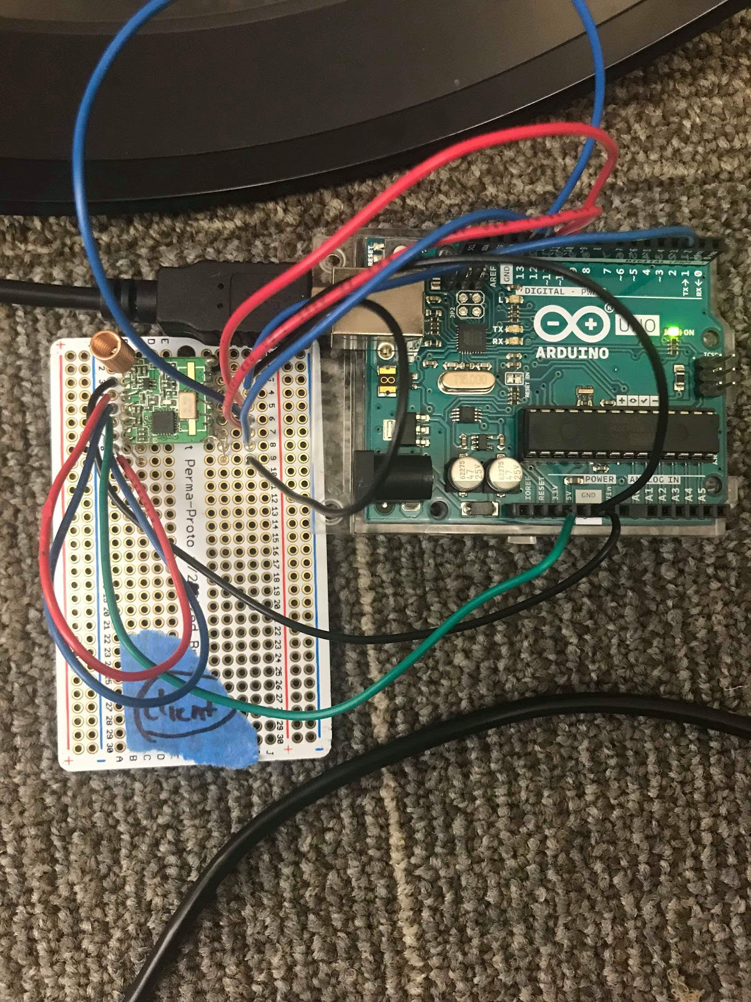
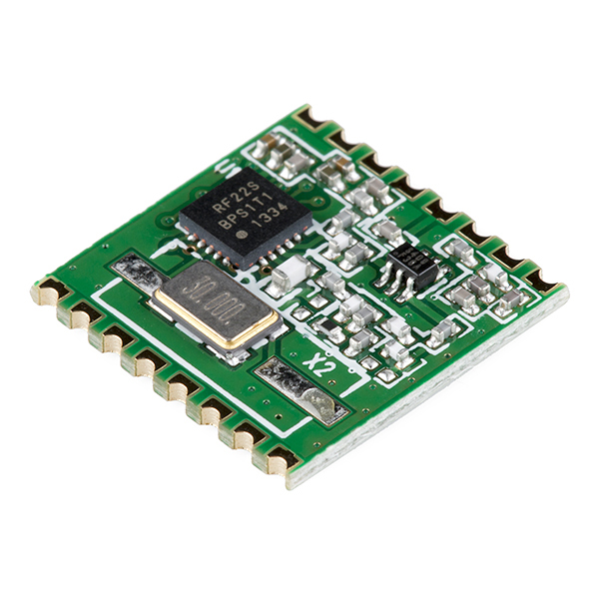
Hardware Approach
Big Picture
Challenge
Solution
Problem
Insight
Future
Needed RF transceiver with digital RSSI
RFM22B ISM Transceiver Module
Arduino Uno support for RFM22B with the RadioHead library

Slide 10
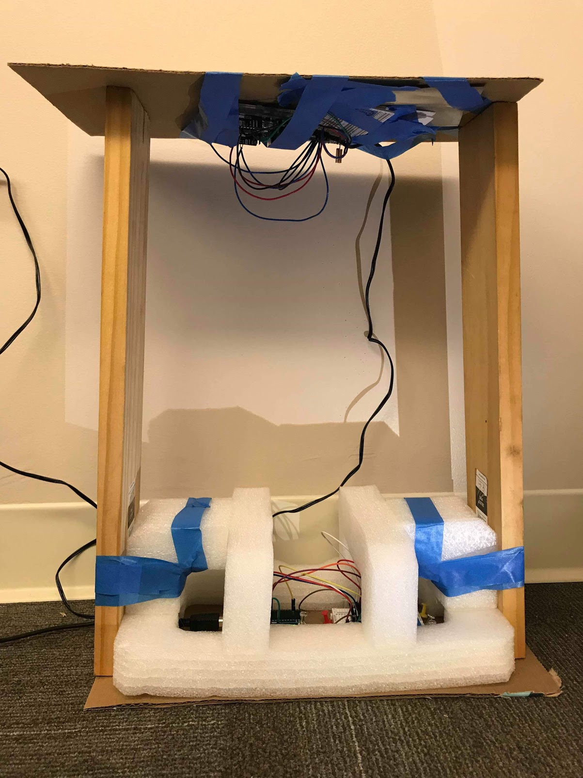
RSSI Reading Test Harness
Big Picture
Challenge
Solution
Problem
Insight
Future
Notes:
Purpose of test harness due to standardize results by minimizing changes in antennas positions which could affect RSSI.

Slide 11
Configuration Considerations
Big Picture
Challenge
Solution
Problem
Insight
Future
The RFM22-B Transceiver allowed us to configure:
Frequency
Range from 433/470/868/915MHz
Power
Range from 1 - 20 dBm output power
From a setup perspective, we needed to determine Transmitter/Receiver Position
Does transmitting/receiving from the “ground” position affect data?

Slide 12
Configuration Considerations - Frequency
Big Picture
Challenge
Solution
Problem
Insight
Future
Simple spring antenna - 915 MHz
2.15dBi of gain
50Ω impedance (required for the RFM22B antenna)
https://www.adafruit.com/product/4269
Notes:
Compatible antenna for 915MHz, limited our frequency to support it.

Slide 13
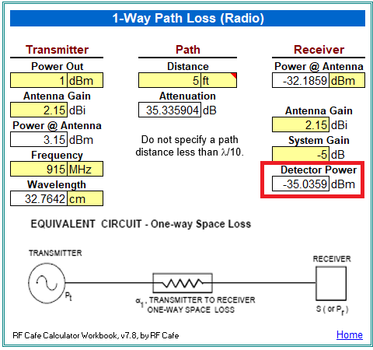
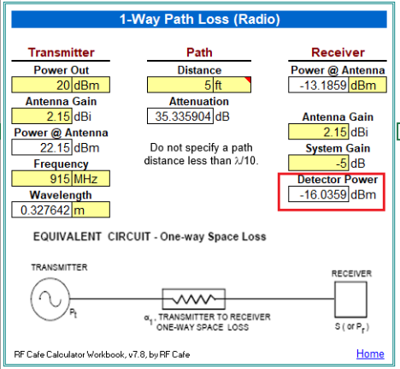
Configuration Considerations - Power
Big Picture
Challenge
Solution
Problem
Insight
Future
Notes:
Path loss means there will be expected reduction in RSSI just from distance traveled, even if nothing was in between transmitter/receiver.
https://www.rfcafe.com/business/software/rf-cafe-calculator-workbook/rf-cafe-calculator-workbook.html

Slide 14
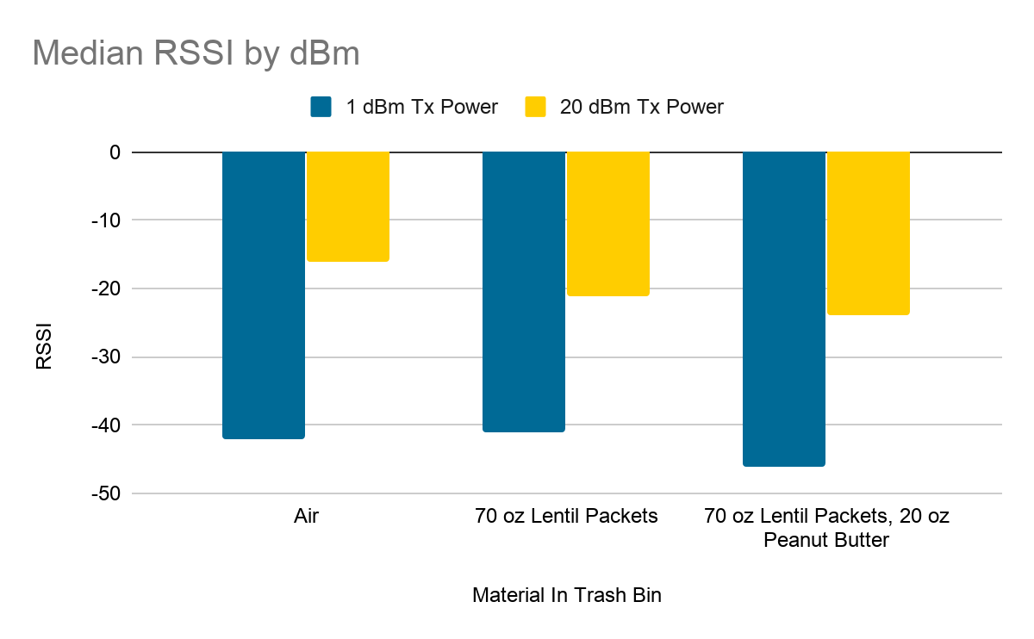
Configuration Considerations - Power
Big Picture
Challenge
Solution
Problem
Insight
Future
Notes:
Lower power, lower signal strength as expected

Slide 15
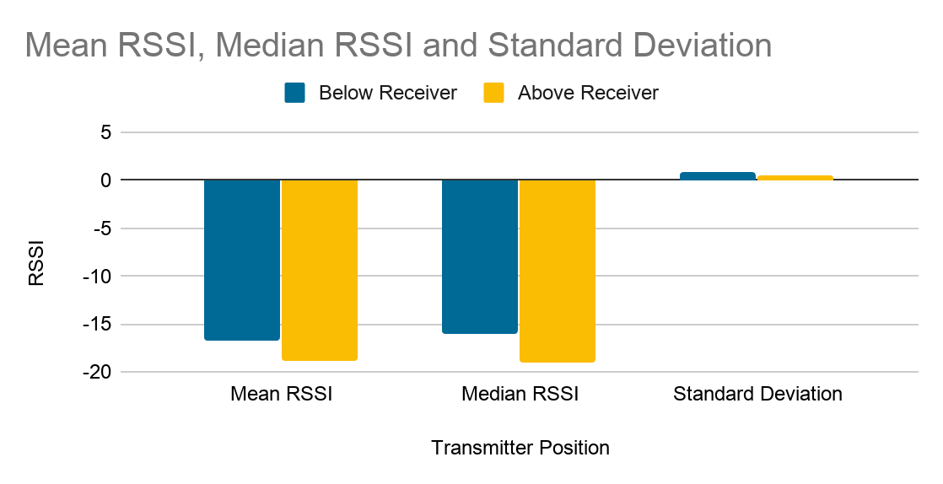
Configuration Considerations -
Transmitter/Receiver Position
Big Picture
Challenge
Solution
Problem
Insight
Future
Notes:
Stability is roughly the same between positions, evident in standard deviation.

Slide 16
Before we collect real trash data...
Big Picture
Challenge
Solution
Problem
Insight
Future
Can the system demonstrate measurable RSSI differences if different materials are placed between the transmitter & receiver?

Slide 17
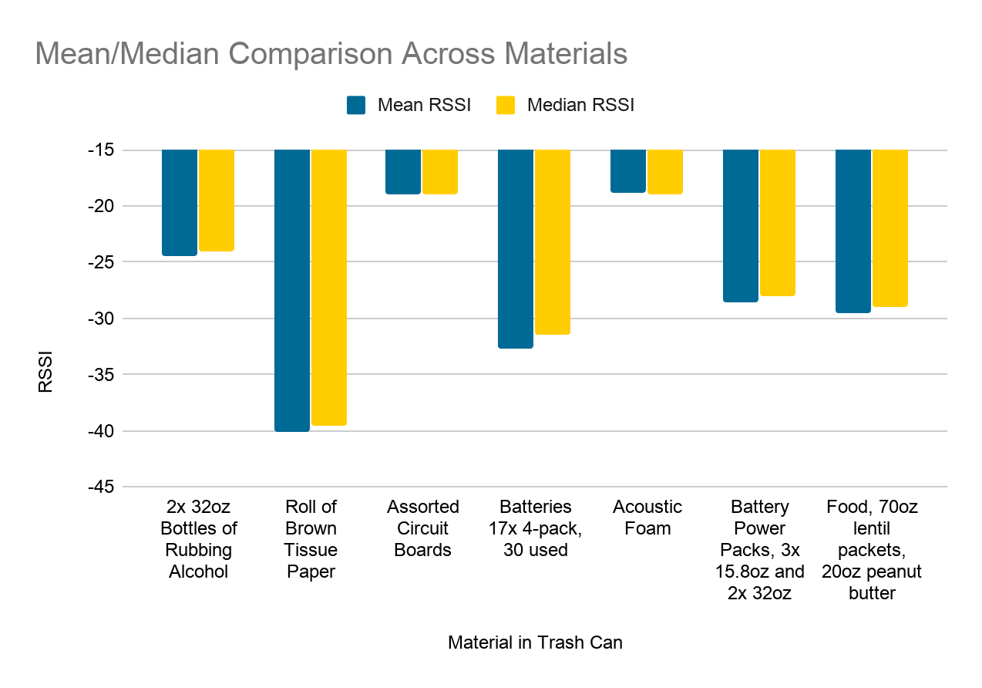
Mean/Median RSSI comparison across materials
Big Picture
Challenge
Solution
Problem
Insight
Future
Notes:
Show median/mean is roughly the same across materials which is why we use median in future charts as a “stable” reading, and the various materials had different mean/median RSSIs.

Slide 18
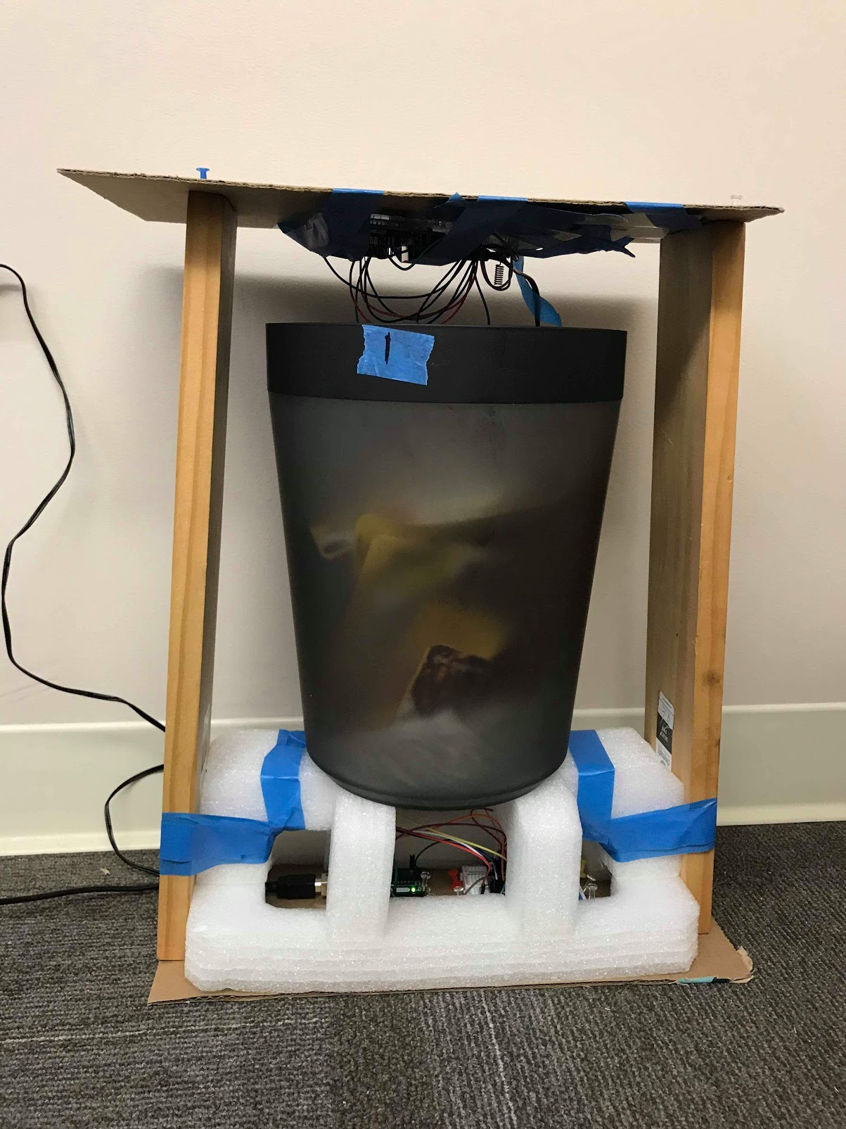
Test Environment - Indoor Lab
Big Picture
Challenge
Solution
Problem
Insight
Future

Slide 19
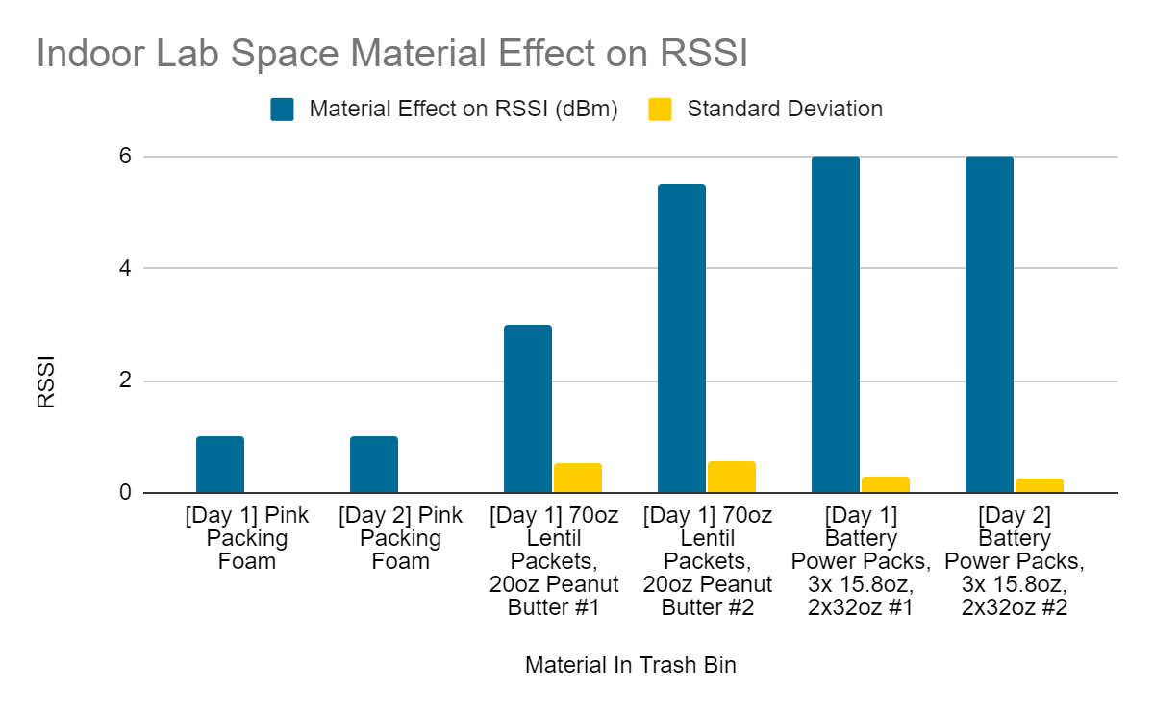
Material Effect on RSSI - Indoor Lab
Big Picture
Challenge
Solution
Problem
Insight
Future
Notes:
Material effect calculated by subtracting the empty reading of RSSI from the material reading.
Material effect on RSSI was positive in indoor lab testing, as if the contents of the bin acted as an amplifier; Weird!!

Slide 20
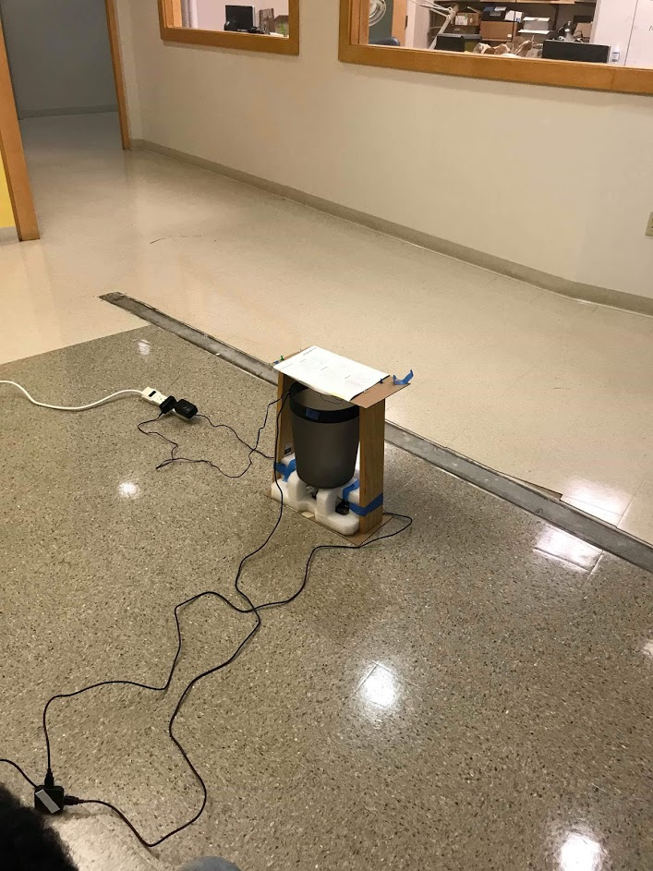
Test Environment - Open Space Indoors
Big Picture
Challenge
Solution
Problem
Insight
Future

Slide 21
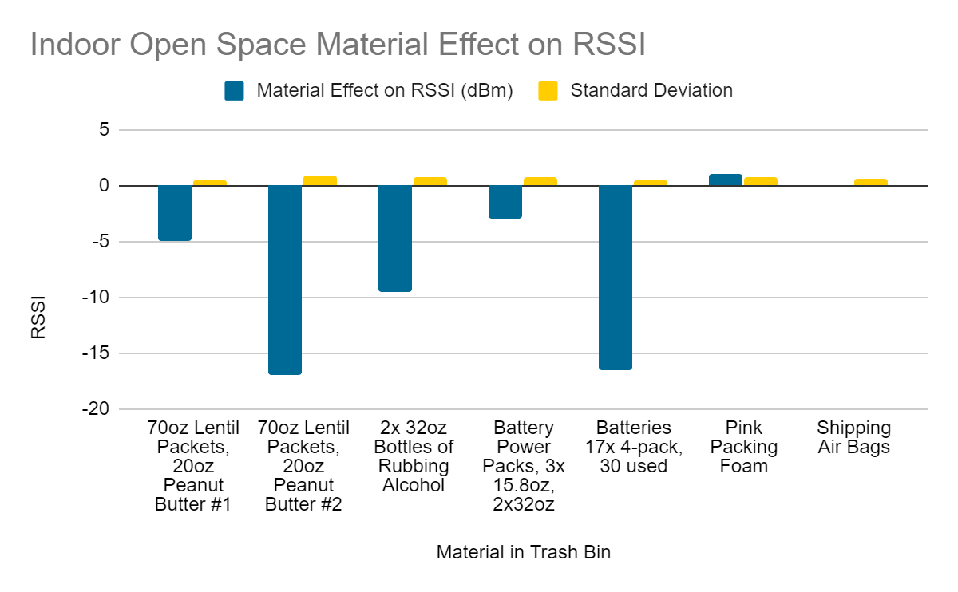
Material Effect on RSSI - Open Space Indoors
Big Picture
Challenge
Solution
Problem
Insight
Future
Notes:
The material effect values were negative as expected, so more promising preliminary test results.

Slide 22
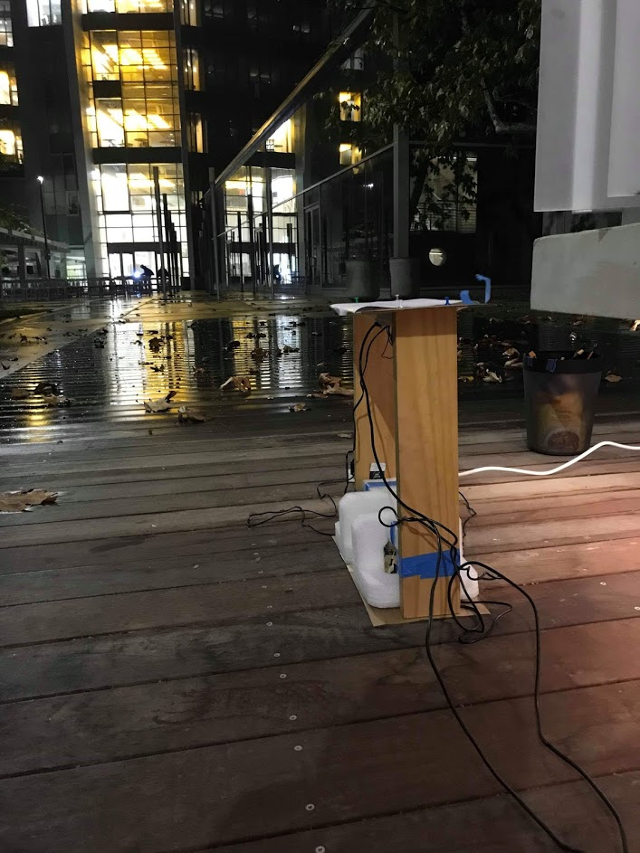
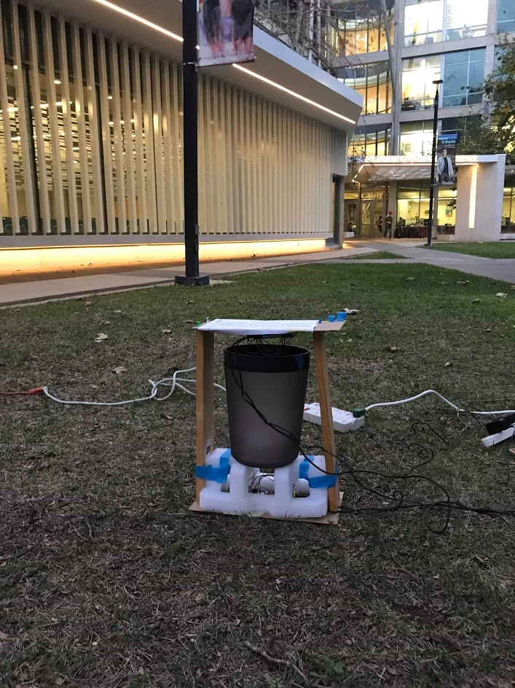
Test Environment - Outdoors
Big Picture
Challenge
Solution
Problem
Insight
Future
Day 1 Testing (Rain) Day 2 Testing (Shine)

Slide 23
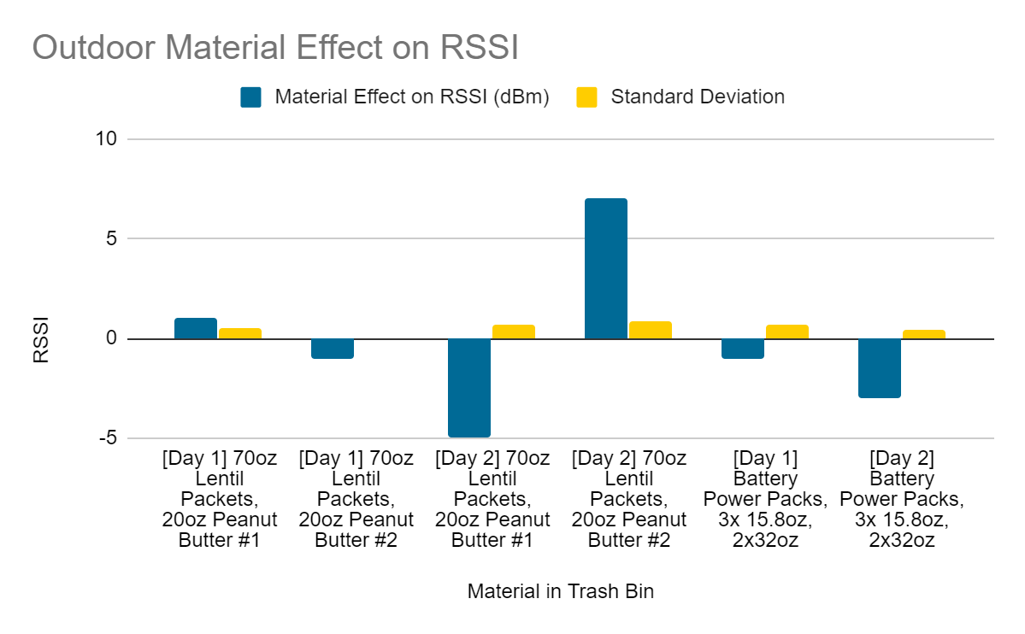
Material Effect on RSSI - Outdoor
Big Picture
Challenge
Solution
Problem
Insight
Future
Notes:
Results in the outdoor case were largely varied, which leads us to conclude that our system works best in open indoor spaces, such as those found in the dining hall.

Slide 24
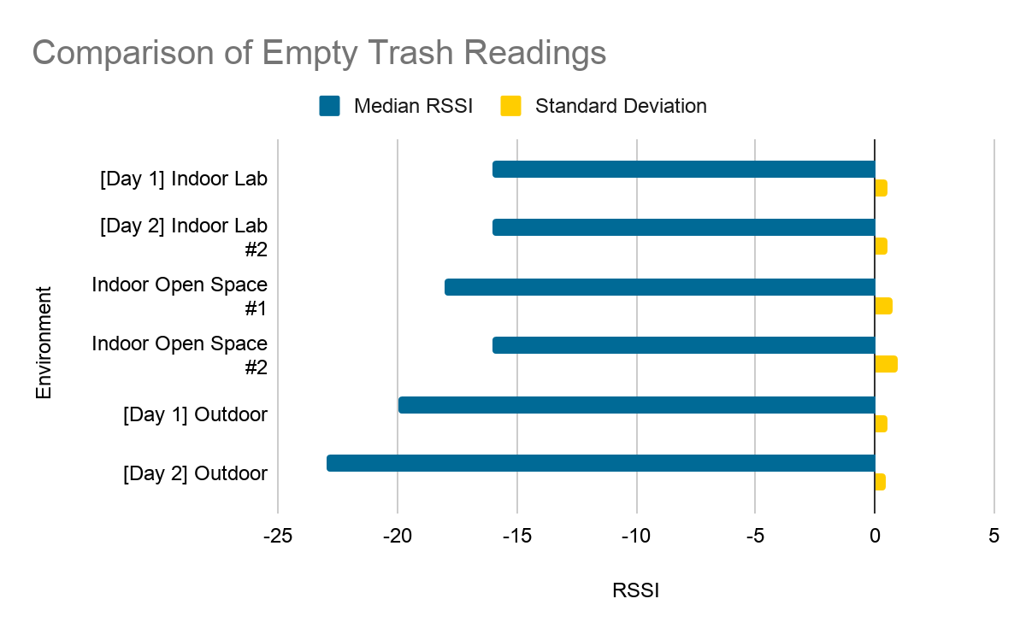
Test Environment Effects on RSSI
Big Picture
Challenge
Solution
Problem
Insight
Future
Notes:
Different test environments had different RSSI baseline readings for empty space. This is possibly because of RF scattering / reflection on nearby surfaces.

Slide 25
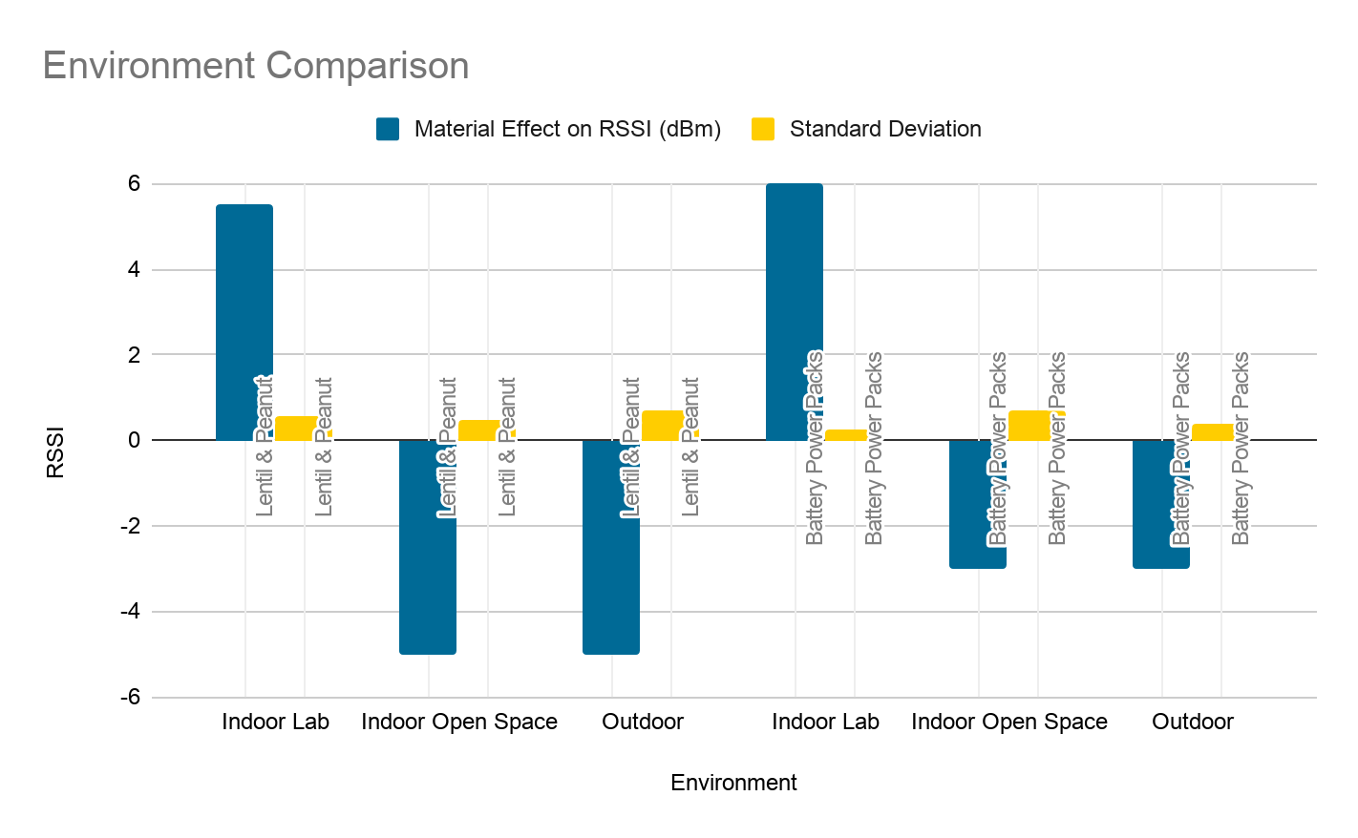
Environmental Effects on RSSI
Big Picture
Challenge
Solution
Problem
Insight
Future
Notes:
We note in different environments, the indoor open space & outdoor performed similarly for at least one set of data

Slide 26
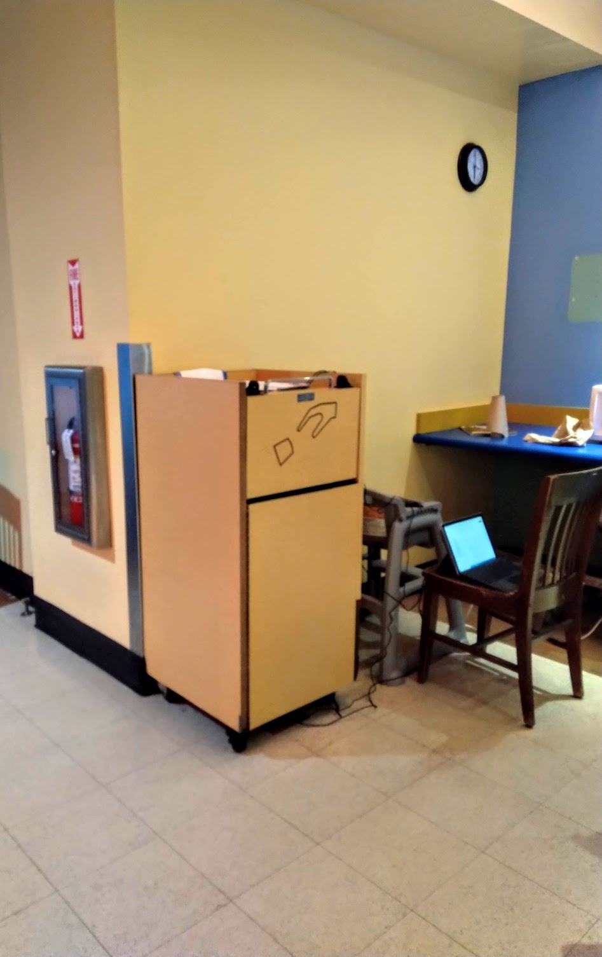

Test Environment - Price Center
Big Picture
Challenge
Solution
Problem
Insight
Future

Slide 27
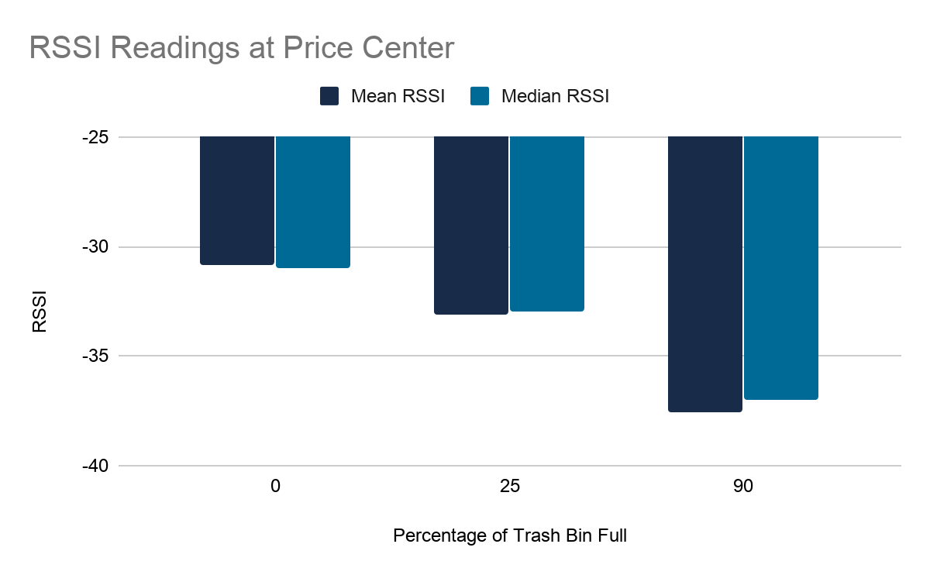
Test Results - Price Center
Big Picture
Challenge
Solution
Problem
Insight
Future
Standard Deviation 0.4045 0.3162 1.3777
Notes:
0.4045, 0.3162, 1.3777

Slide 28
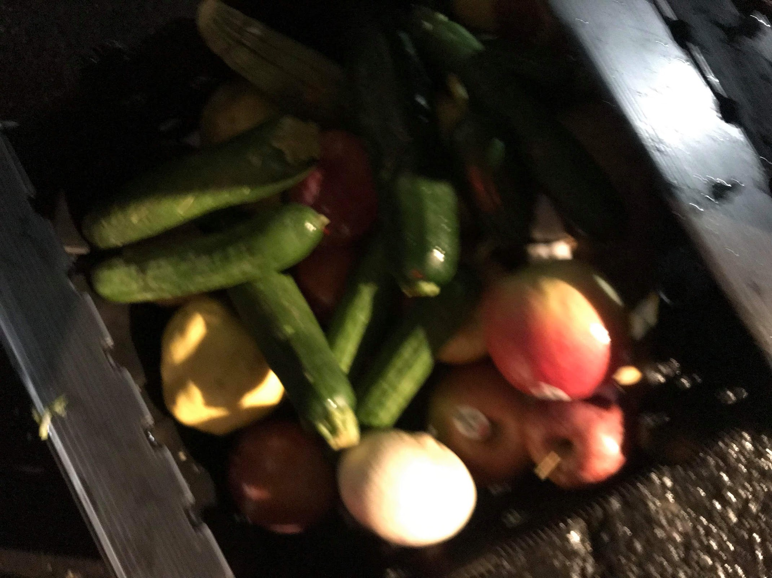
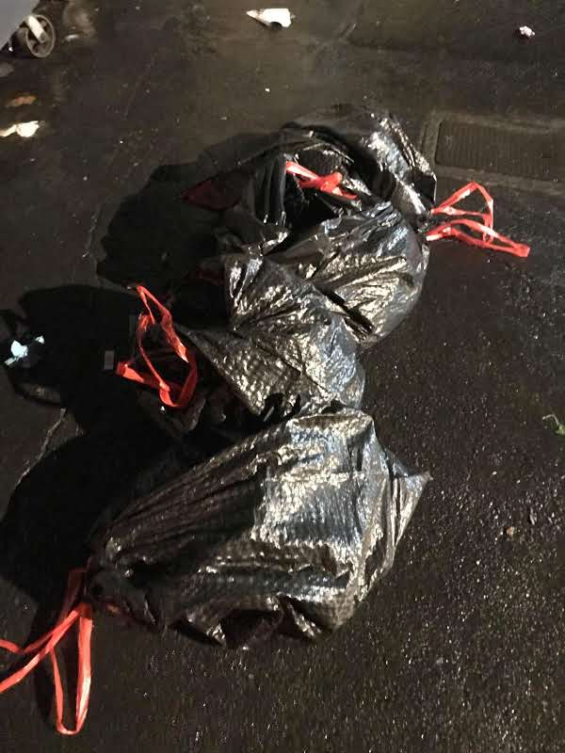
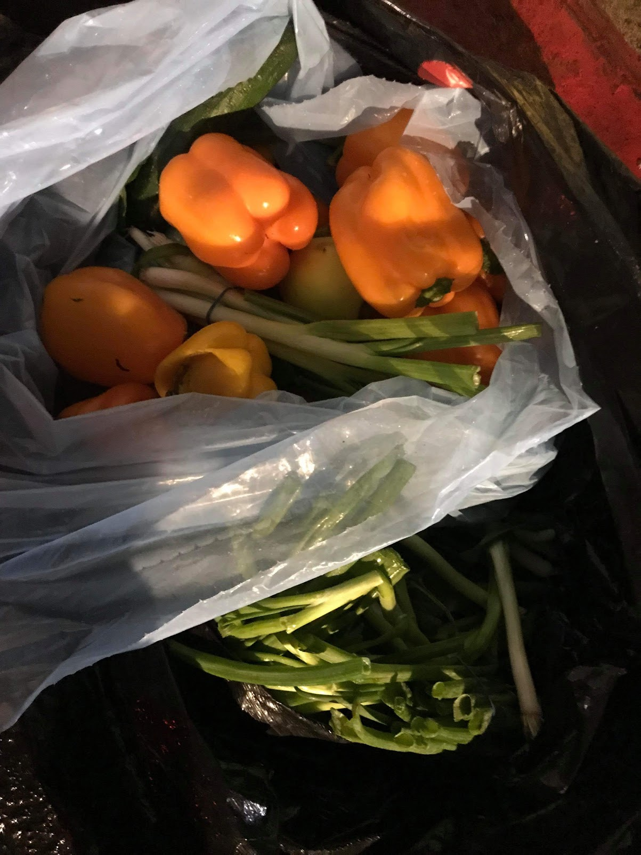
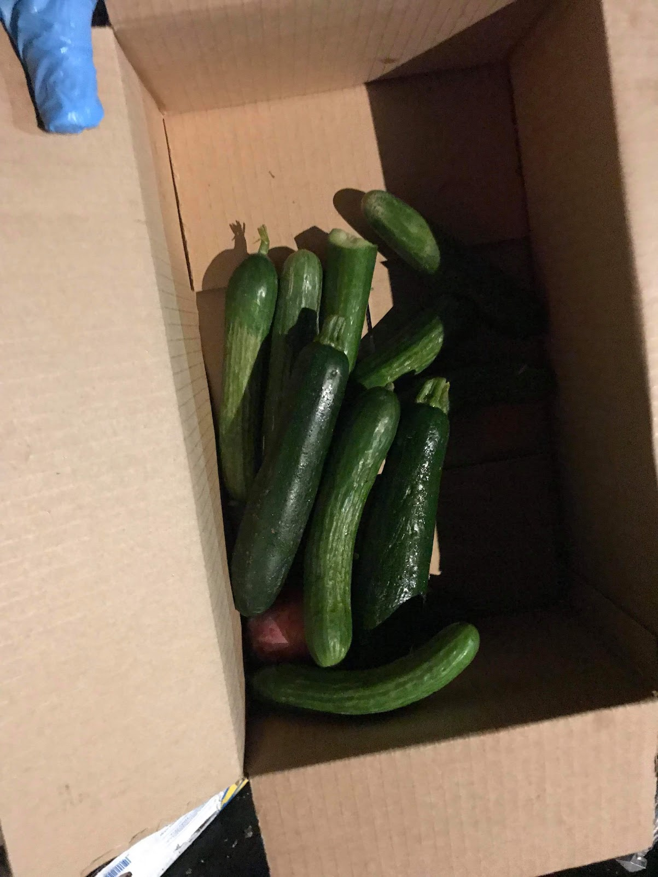
Grocery Waste - Test Data
Big Picture
Challenge
Solution
Problem
Insight
Future
Abundant “test data” fruit/vegetables thrown out by local grocery stores.
54.4lb food reclaimed for testing.

Slide 29
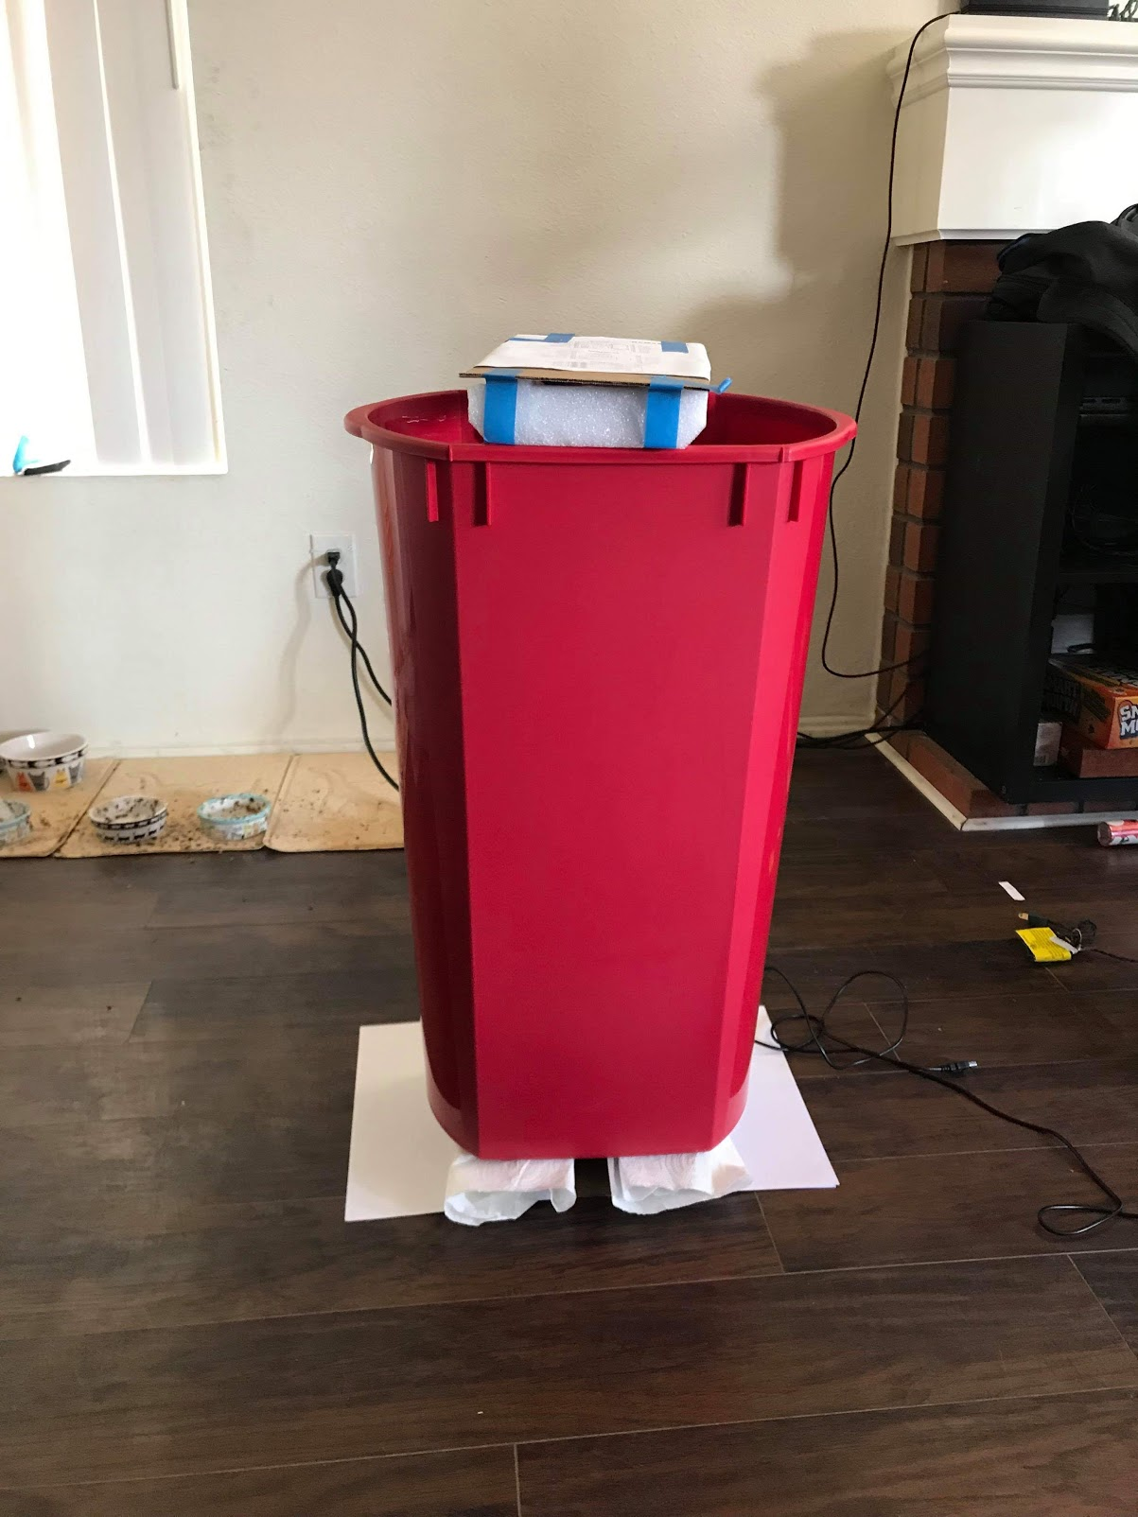
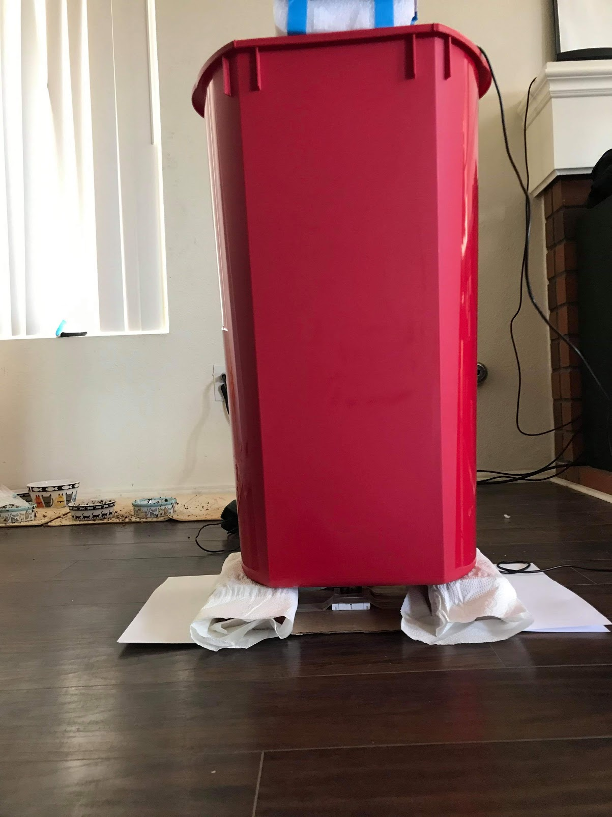
Grocery Waste - Brick Trash Bin Riser Placement
Big Picture
Challenge
Solution
Problem
Insight
Future
Placement of bricks to hold the trash can have a big effect on the RSSI spread between empty / full (43.8lb food)
1” Distance from Server 4” Distance from Server

Slide 30
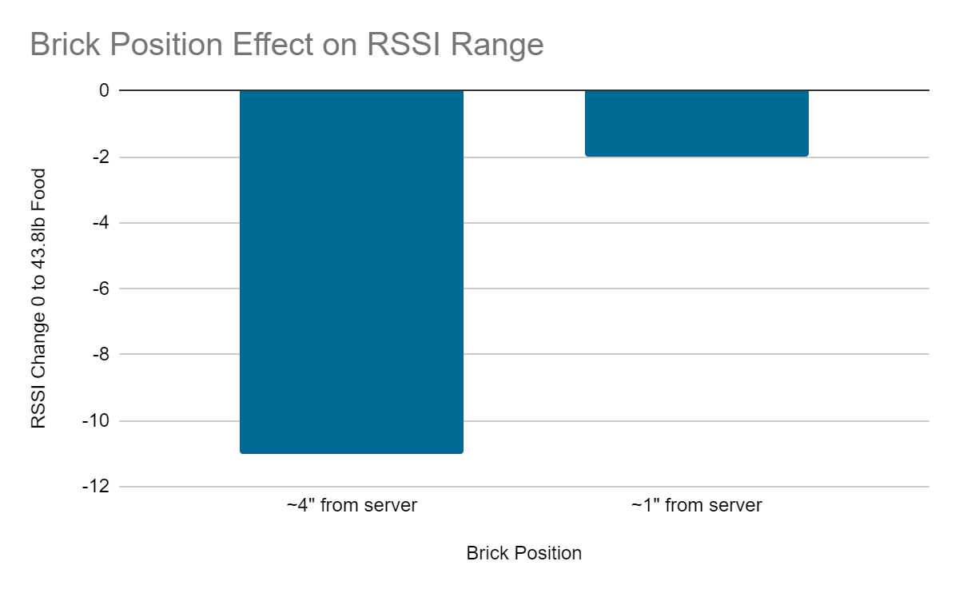
Grocery Waste - Riser Brick Placement
Big Picture
Challenge
Solution
Problem
Insight
Future

Slide 31
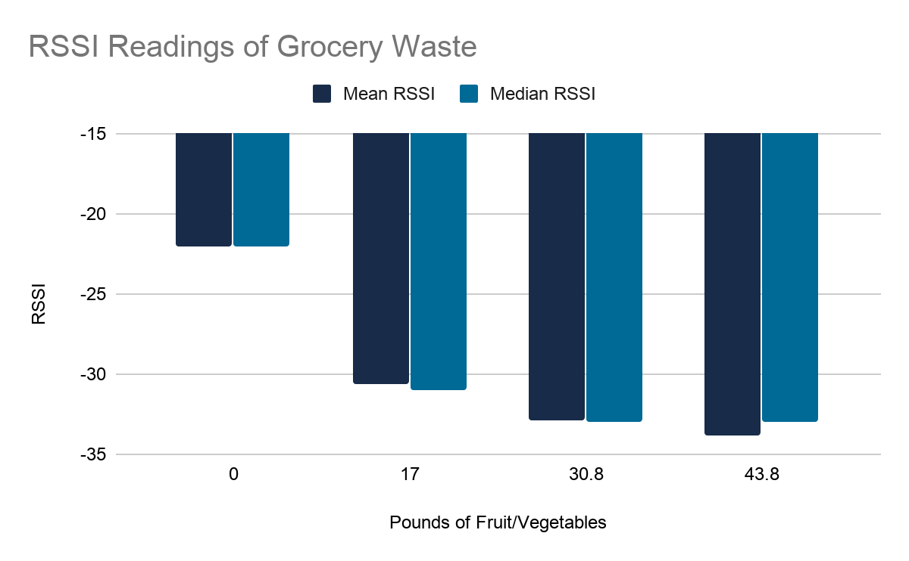
Test Results - Grocery Waste
Big Picture
Challenge
Solution
Problem
Insight
Future
Standard Deviation 0 0.5164 0.3162 2.251

Slide 32
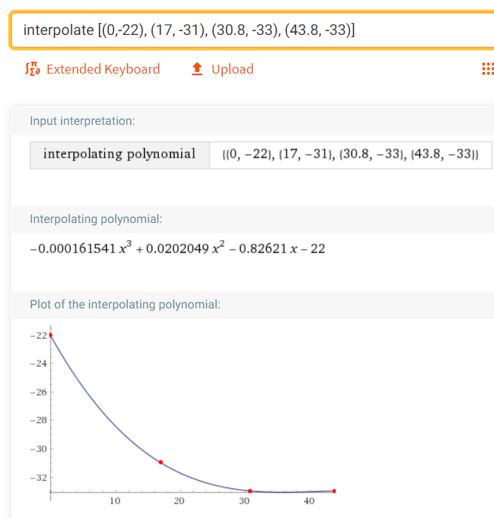
Grocery Waste - Waste Prediction
Big Picture
Challenge
Solution
Problem
Insight
Future
Interpolate previous weight & RSSI readings to build
RSSI model of waste in the bin, weight (lb) vs RSSI.
An additional 10.6lb fruit/vegetable bag reading not used in previous measurements alone in bin had median -27 RSSI
Solving the polynomial for weight:
-0.000161541*x³ + 0.0202049*x² - 0.82621*x - 22 = -27
x = 7.2lb predicted, 32% error
Computations from Wolfram Alpha

Slide 33
Future Considerations
Big Picture
Challenge
Solution
Problem
Insight
Future
The insight really allows us to measure the presence of something without seeing or physically touching it. If we could find an application for this, further research into that could be done.
We can potentially achieve a higher fidelity estimation using Software Defined Radios to measure the actual energy received, instead of using RSSI. We could also use a more mono-directional antenna.
Notes:
Signal the end
Summarize the key takeaway
Make the ask → Call for action
Use a clincher

Slide 34
Thank You

Slide 35
Backup

Slide 36
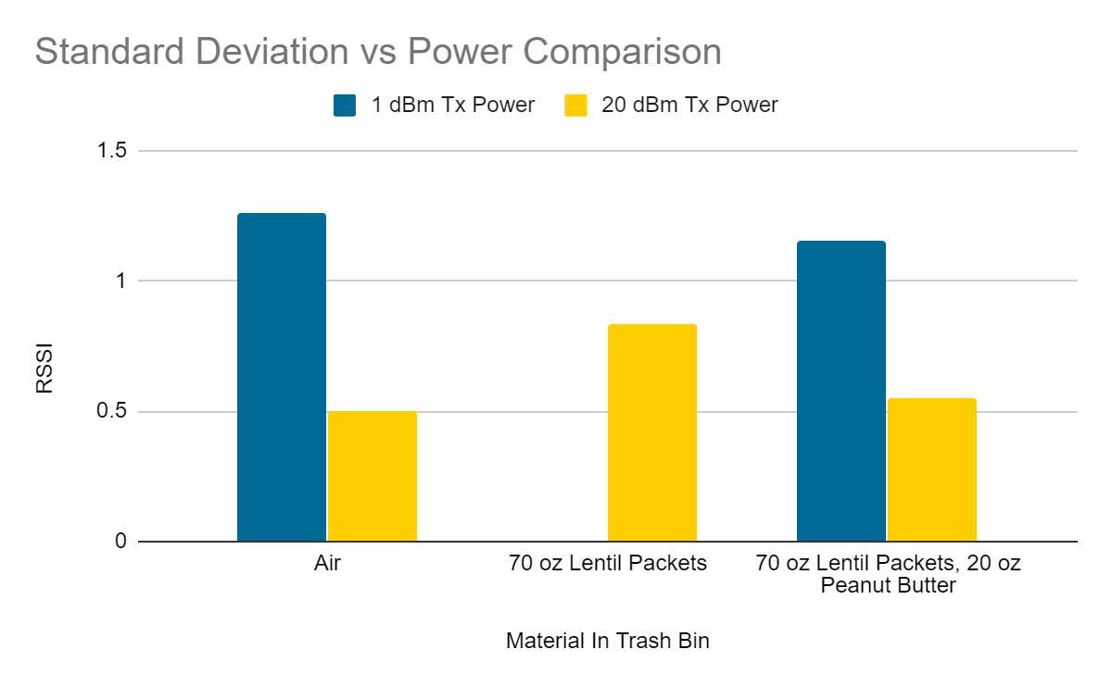
Configuration Considerations: Power

Slide 37
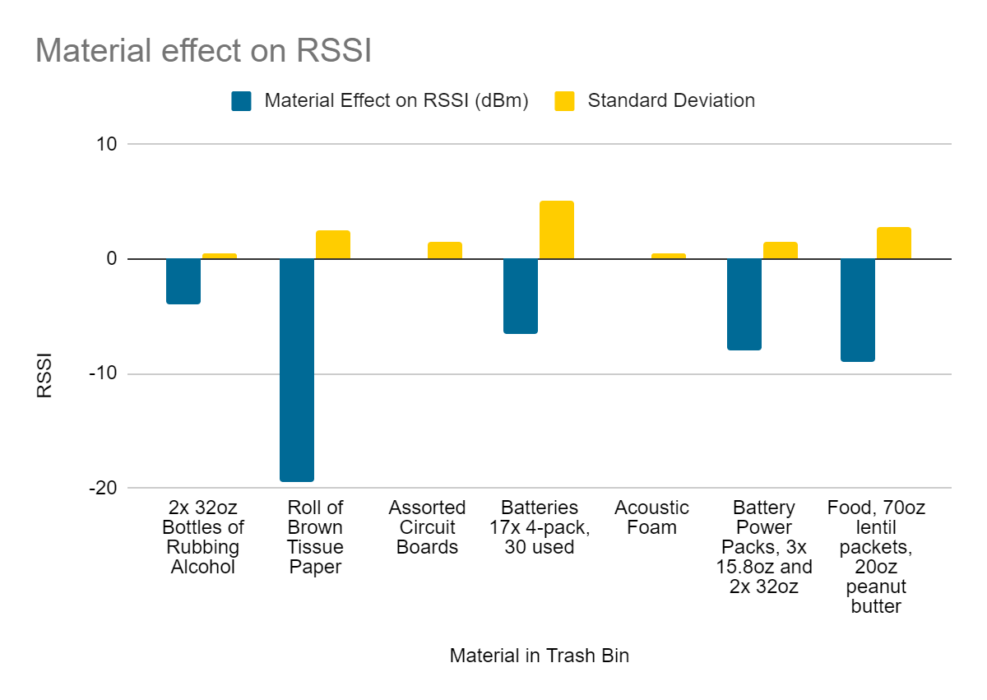
Effect of different materials on RSSI
Notes:
Material effect calculated by subtracting the empty reading of RSSI from the material reading.

Slide 38
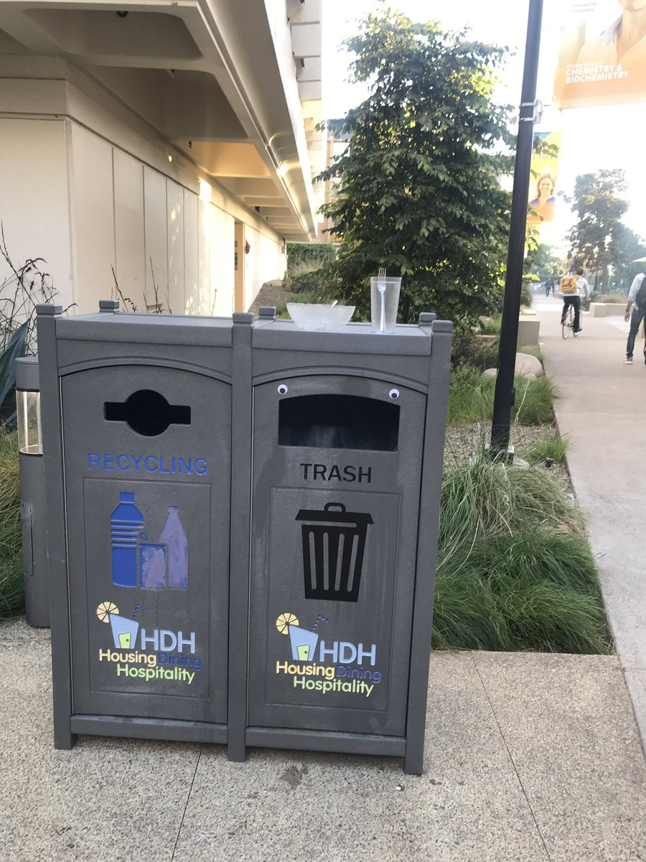


Slide 39
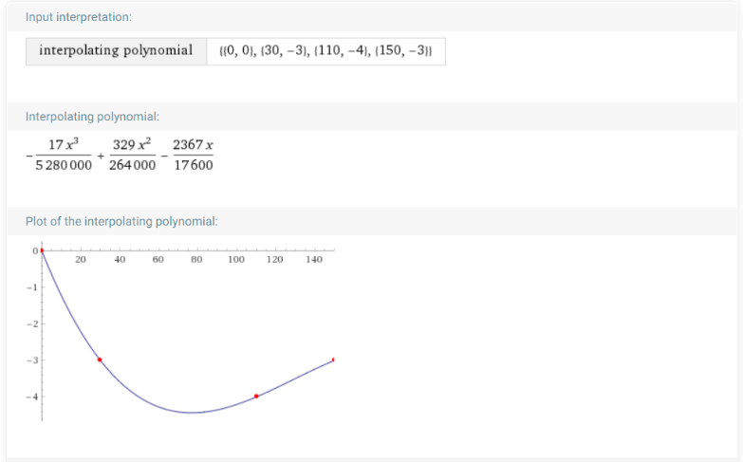
RSSI model for food in lab indoors
RSSI median readings at 3 different food weights (30, 110, 150 oz) taken in the indoor lab
Weight vs Material Effect of RSSI used to build polynomial to estimate food in bin from RSSI
Notes:
We took the Material Effect of 3 different food measurements in the lab to build a model of RSSI vs Food Weight (Oz)

Slide 40
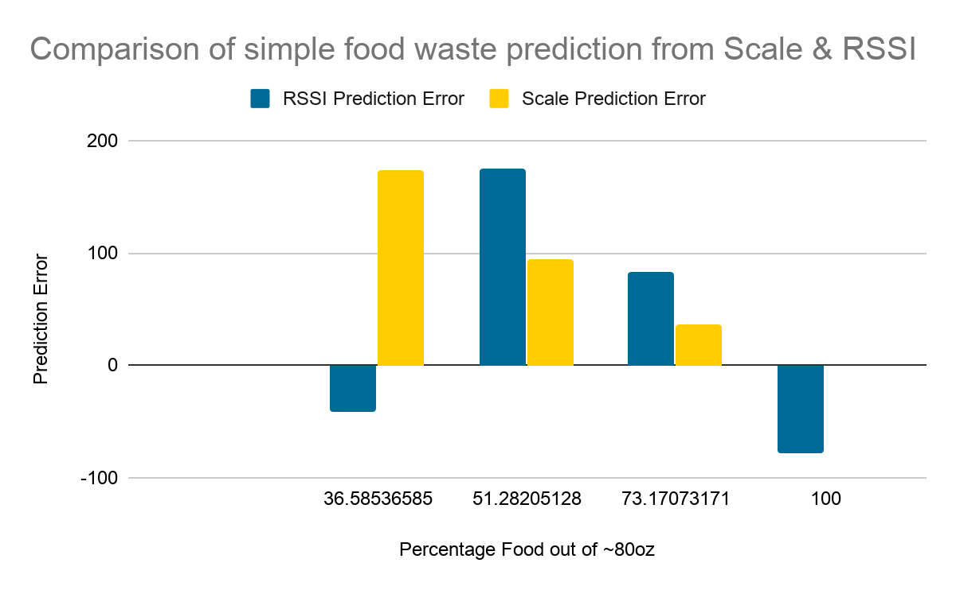
RSSI v/s Weight Error

